Slide 1
FY 2027 BUDGET FORA
Medium-Term Fiscal Framework Expenditure Management Framework
January 28-29, 2026 SMX Convention Center
Director Mary Joy O. de Leon
Fiscal Planning and Reforms Bureau

Slide 2
Outline of Presentation
Overview of PFM Framework
Medium-Term Fiscal Framework
Expenditure Management Framework

Slide 3
The Challenge
₱
RESOURCES
NATIONAL BUDGET
DEVELOPMENT NEEDS

Slide 4
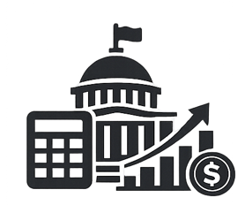
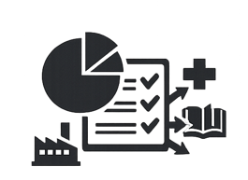
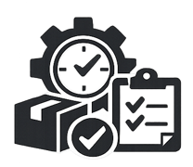
Desirable Outcome of the Budget
aggregate fiscal discipline
PFM
Objectives
allocative efficiency
operational efficiency

Slide 5
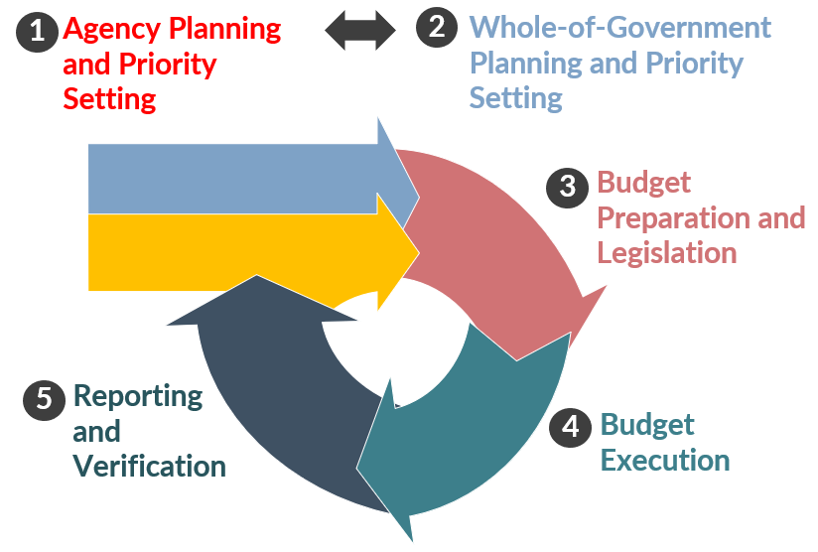
The PFM Cycle
Key considerations during budget review:
Alignment with agency
mandates and government
priorities
(2) Agency’s absorptive
capacity
(3) Implementation readiness
of programs and projects
(4) Availability of fiscal space

Slide 6
Medium-Term Fiscal Framework 2022-2030
ORIGINAL TARGETS^{1/} | REVISED TARGETS^{2/}
6.5 to 7.5% real GDP growth in 2022 | -
6.5 to 8.0% real GDP growth annually between 2023 to 2028 | 5.5 to 6.5% in 2025 6.0 to 7.0% from 2026 to 2030
9.0% (i.e., single digit) poverty rate by 2028 | -same-
3.0% NG deficit-to-GDP ratio by 2028 | 3.1% NG deficit-to-GDP ratio by 2030
Less than 60.0% NG debt-to-GDP ratio by 2025 | Less than 60.0% NG debt-to-GDP ratio by 2029
At least US$4,256 GNI per capita (attainment of UMIC status) | At least US$4,496 GNI per capita (attainment of UMIC status)^{3/}
Since its implementation in 2022, MTFF helped the country achieve macroeconomic stability, a robust and regionally competitive economy, and improved fiscal health Unforeseen headwinds warranted updating of MTFF to ensure that it remains realistic and supportive of growth The Philippines remains on a steady path towards achieving its macro-fiscal targets in the original MTFF by 2030
1/ Adopted by Congress through Concurrent Resolution No. 4 dated September 19, 2022
2/ Medium-Term Fiscal Framework 2022-2030 Midterm Update published on October 2025
3/ Based on the minimum income threshold for upper-middle income countries using the World Bank Group’s updated country income classifications for Fiscal Year 2026 (July 1, 2025 – June 2026)

Slide 7







Expenditure Management Framework
Philippine Development Plan Midterm Update 2023-2028
Medium-Term Fiscal Framework 2022-2030 Midterm Update
serves as a roadmap leading toward achieving the Agenda for Prosperity in the Bagong Pilipinas
reflects the governments commitment to prudent fiscal programming, sound fiscal management
Digitalization efforts
Build Better More Program
commitment to infrastructure development
promote a more transparent, accountable, and efficient bureaucracy
LGU capacity-building programs
enable LGUs to assume devolved functions
Harmonization of Regional Plans with National Priorities
Implementation of EO 103 s. 2025
enhance planning and budgeting linkages to achieve equitable regional investment opportunities and growth
LGUs are recognized as the primary providers of direct service delivery to their constituents

Slide 8





Expenditure Management Framework cont.
2-Tier Budgeting Approach (2TBA)
strengthen the strategic decision-making process by separating the evaluation of agency proposals
Unified Accounts Code Structure (UACS)
harmonized coding structure to facilitate financial reporting and consolidation of government revenue and expenditures
Program Expenditure Classification (PREXC)
a form of structuring the budget into programs and outcomes
Disaggregation of lump-sum amounts
disaggregating amounts within agency specific budgets to reflect PAPs, implementing agencies and/or regional or local levels
Cash Budgeting System (CBS)
funding is focused on programs and projects that are implementation-ready and can be completed within the fiscal year

Slide 9





Expenditure Management Framework cont.
Monitoring and Evaluation System
well-functioning monitoring system will provide evidence-based information
Program Convergence Budgeting
link, harmonize, and synchronize critical program interventions
Open Government Partnership
key platform for transparency and citizen participation
Participatory Budgeting
promote efficient use of public funds and ensure sustainable development through meaningful citizen participation
Government Optimization Program
eliminate overlapping mandates and streamlines agency operations to improve service delivery

Slide 10

Key Messages on FY 2027 Budget Preparation
Optimize the allocation of the FY 2027 Budget considering the impact of the country’s debt burden and the competing demands of government agencies.
Evaluate considering the utilization of the previous years’ budget of the agencies, and the implementation progress of their mandated programs and projects.
Ensure that only those agency proposals, which are implementation-ready, are included in the budget.
Capacitate the local government units to effectively and efficiently implement devolve functions.
Ensure the alignment of regional plans with national priorities through a strong coordination between the RDCs and AROs.

Slide 11
Thank you!

